Slide 1

Pacman search
AI
TEAM MEMBERS:
AYA AHMED ALI
AYA MEDHAT MOSTAFA
AMIRA EID RAMADAN
PRODUCED TO : DR / Mahmoud Atef ENG/ MAI shaban

Slide 2
Contents:
Introduction
Search with Single dot(goal)
Depth First Search
Breadth First Search
Gready search
A* Search
Conclusion of Search with Single dot(goal)
Search with multiple dots(goals)
Using A* Search
Using Breadth First Search
Conclusion of Search with multiple dot(goal)

Slide 3
introduction
In this project we are experimenting with 4 main search algorithms :-
- Depth First Search
- Breadth First Search
- Gready Search
- A* search
we will compare these 4 different search algorithms and compare them in terms of:
- Path cost
-expanded nodes

Slide 4
Search with Single dot(goal)

Slide 5
1-Depth First Search

Slide 6
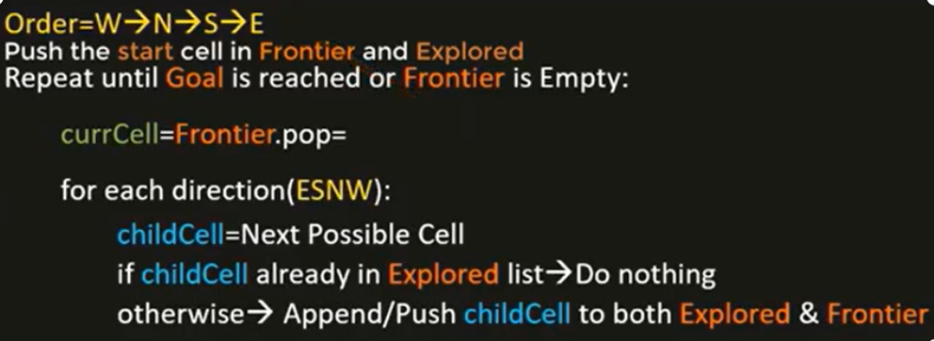
Pesudo code
DFS use stack data structure(FILO)

Slide 7
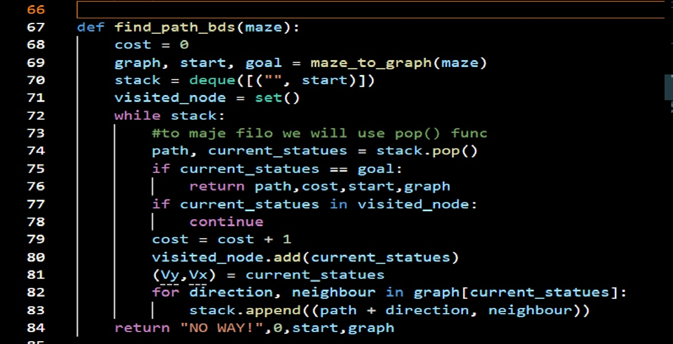
code

Slide 8
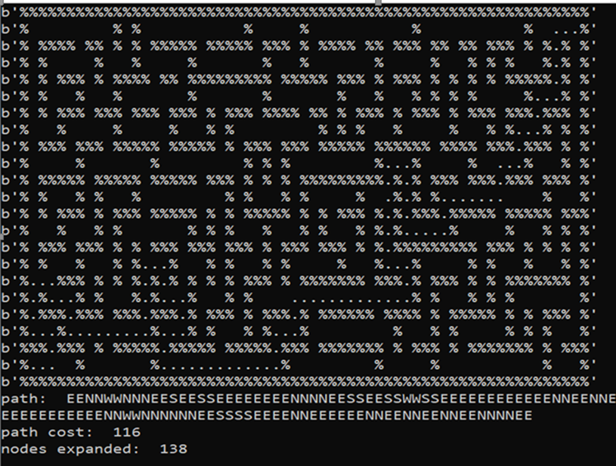
Result code
Medium maze
Path cost: 116
Node expanded: 138

Slide 9
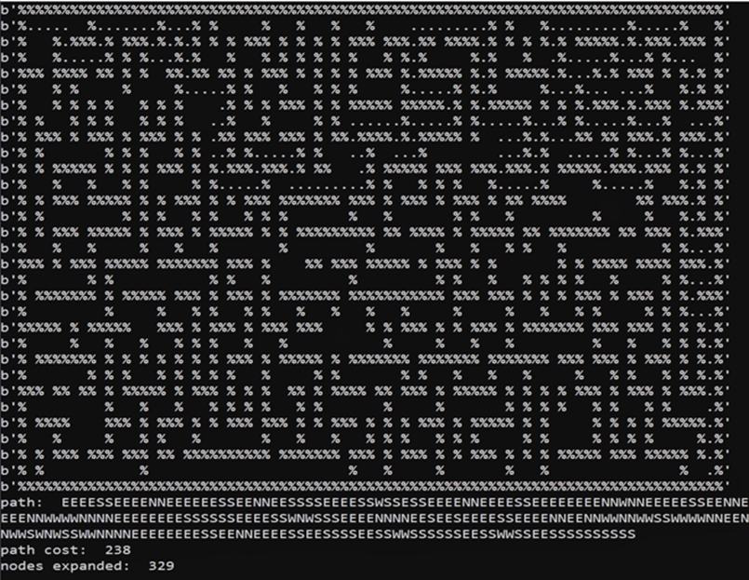
Result code
Big maze
Path cost: 238
Node expanded: 329

Slide 10
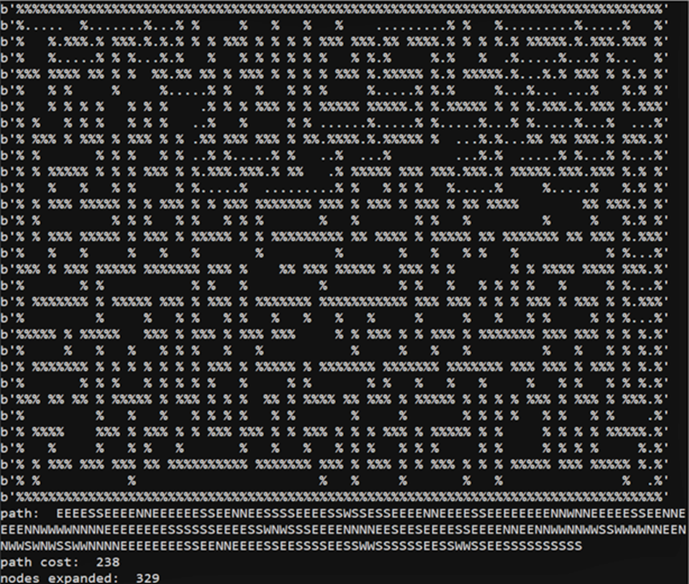
Result code
Open Maze
Path cost: 238
Node expanded: 329

Slide 11
2- breadth First Search

Slide 12
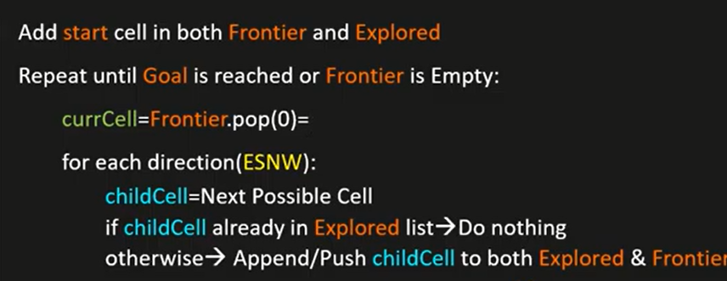
Pesudo code
BFS use queue data structure(FIFO)

Slide 13
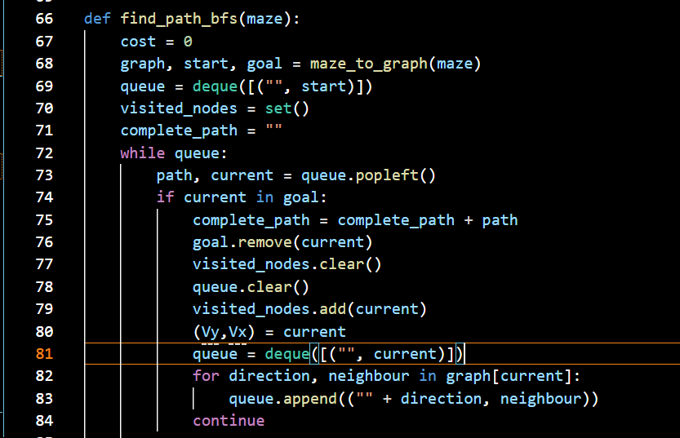
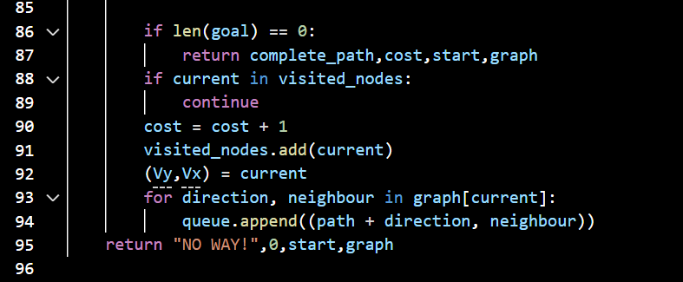
code

Slide 14
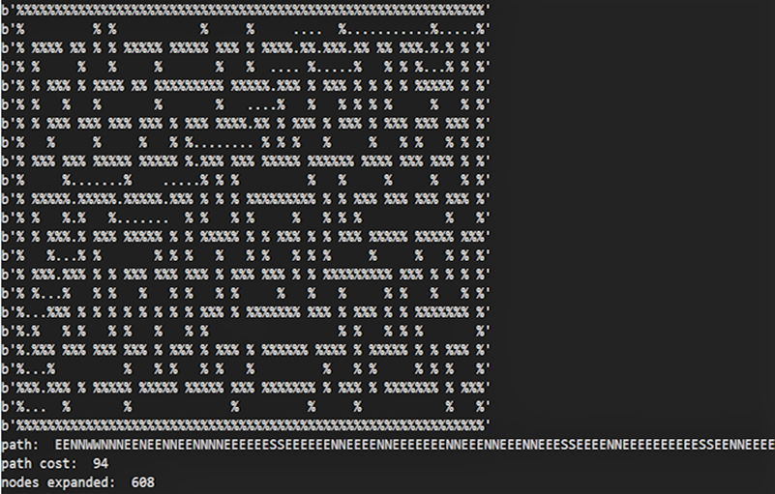
Result code
Medium maze
Path cost: 94
Node expanded: 608

Slide 15
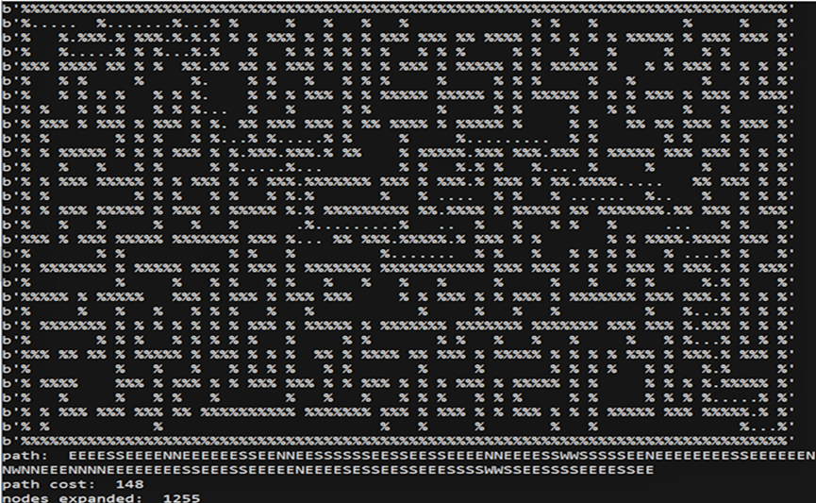
Result code
Big maze
Path cost: 148
Node expanded: 1255

Slide 16
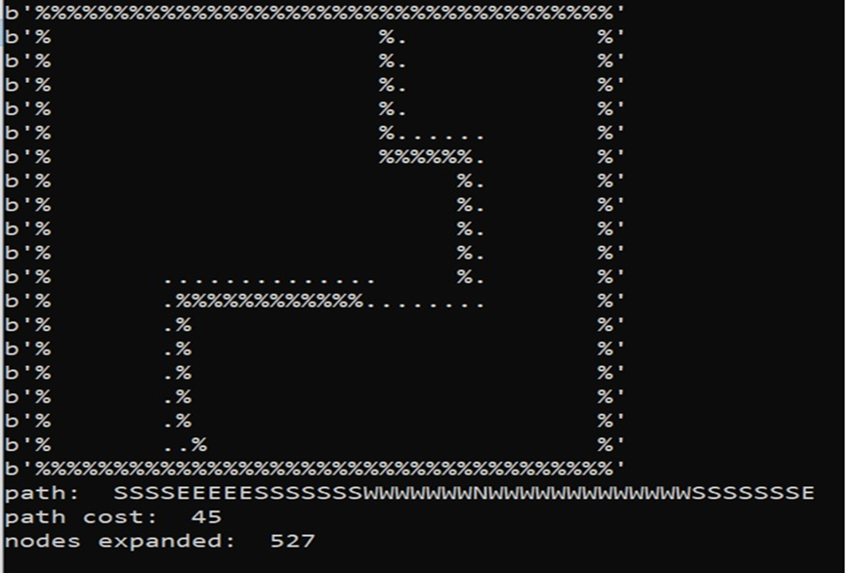
Result code
Open Maze
Path cost: 45
Node expanded: 527

Slide 17
3- A* Search

Slide 18
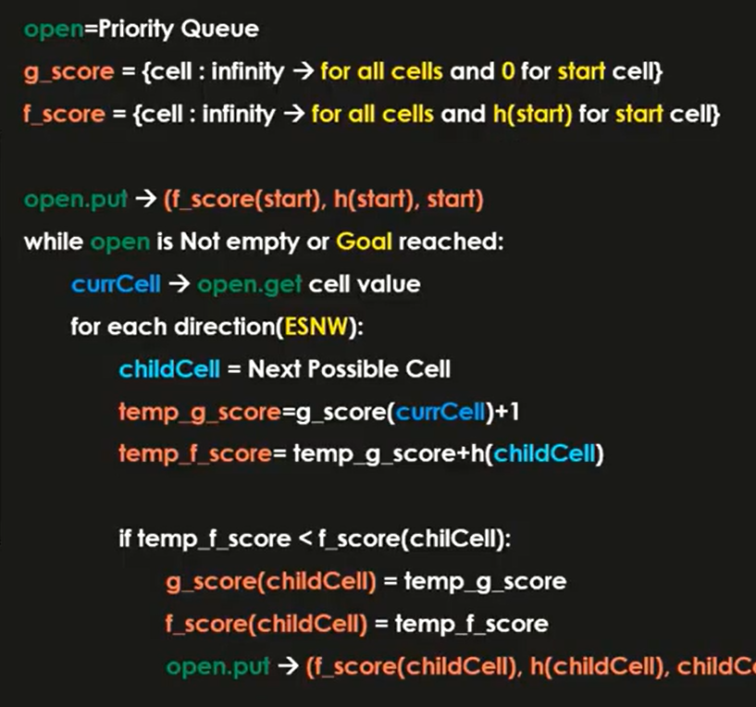
Pesudo code
A*use priority queue data structure which order values from smaller to larger and pop the smallest value.

Slide 19
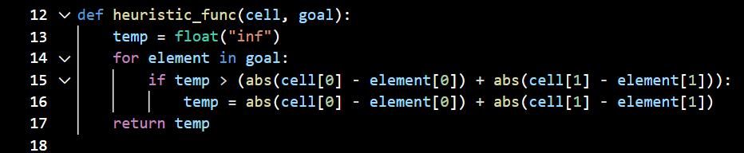
code

Slide 20
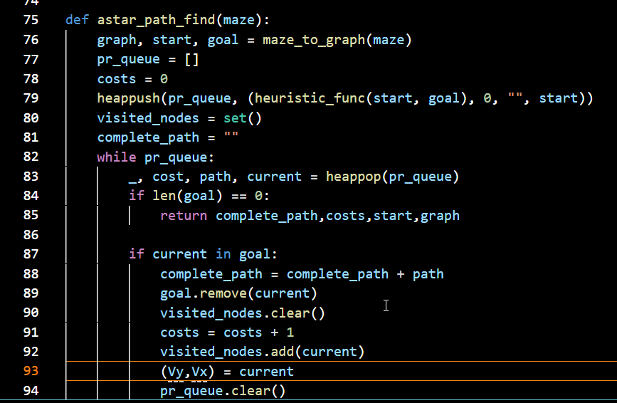
code

Slide 21
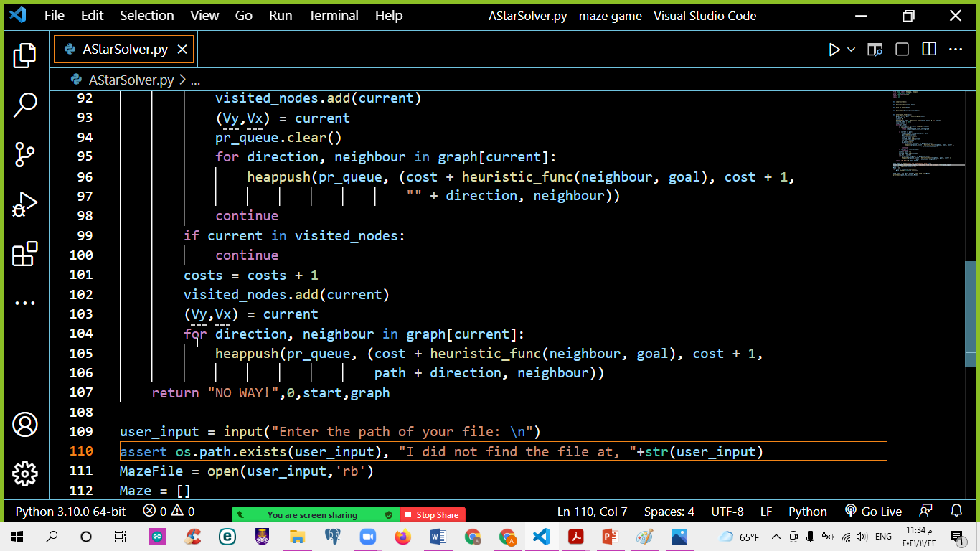
code

Slide 22
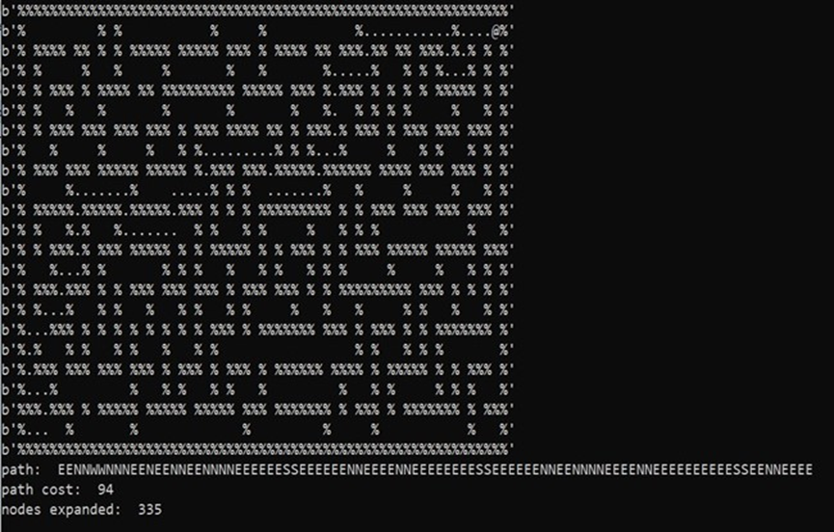
Result code
Meduim Maze
Path cost: 94
Node expanded:335

Slide 23
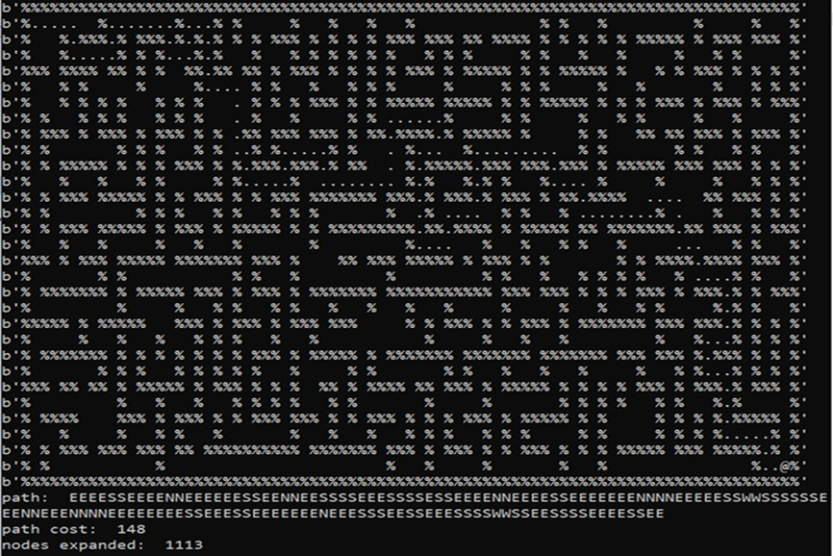
Result code
Big Maze
Path cost: 148
Node expanded: 1113

Slide 24
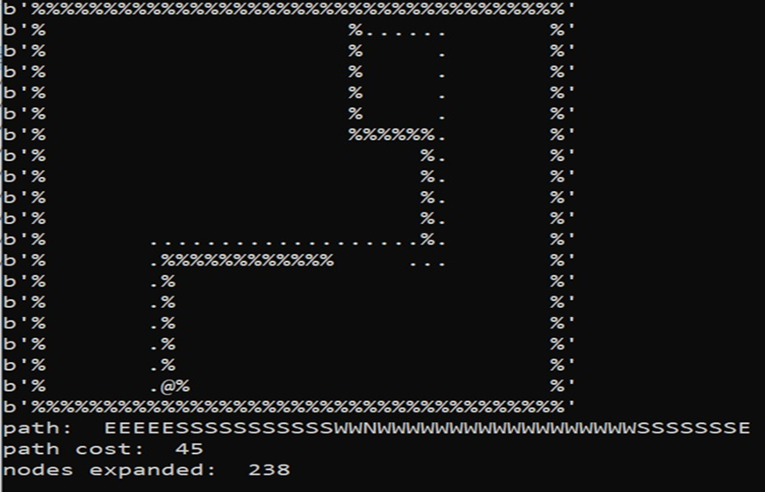
Result code
Open Maze
Path cost: 148
Node expanded: 1113

Slide 25
4- Greedy Best First search

Slide 26
code

Slide 27
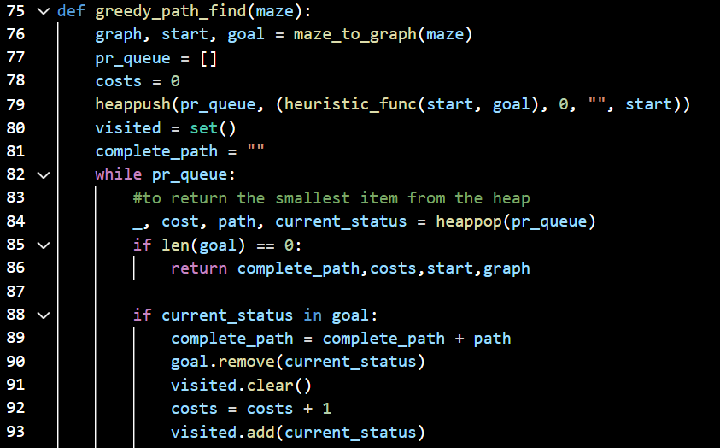
code

Slide 28
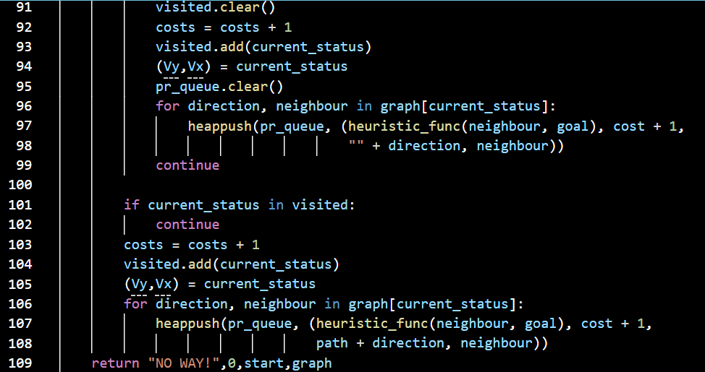
code

Slide 29
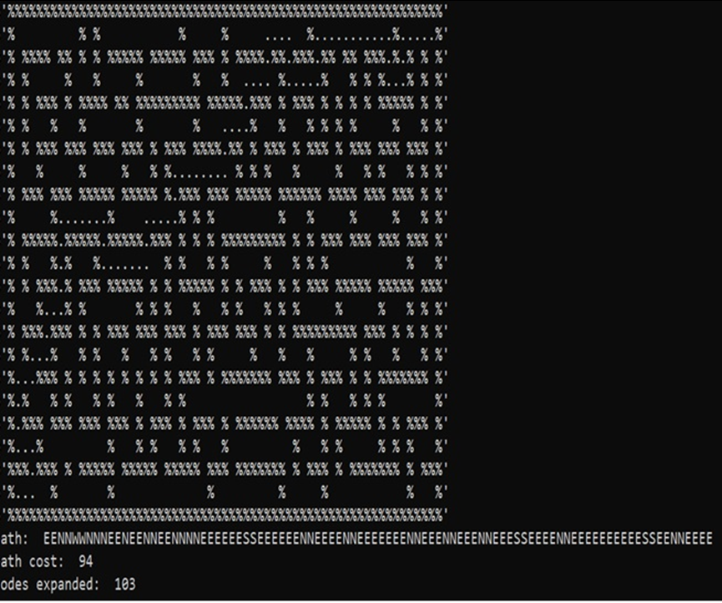
Result code
Meduim Maze
Path cost: 94
Node expanded:103

Slide 30
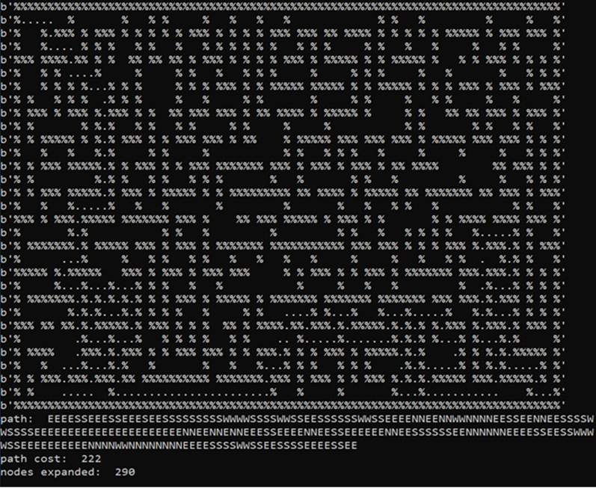
Result code
Big Maze
Path cost: 222
Node expanded: 29

Slide 31
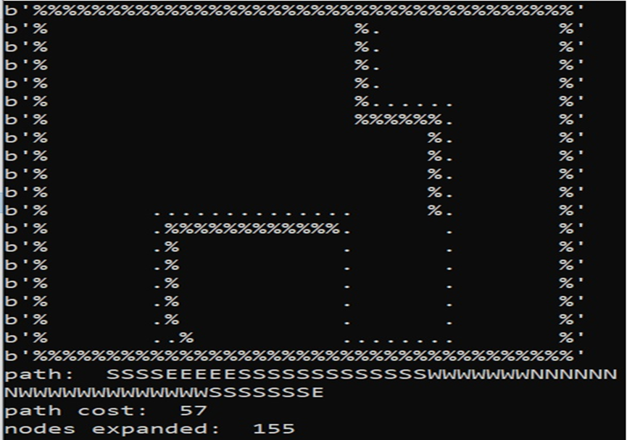
Result code
Open Maze
Path cost: 57
Node expanded: 155

Slide 32
Conclusion of Search with Single dot(goal)

Slide 33
 | Path cost |  |  | Expanded nodes
 | medium | big | open | medium | big | open
DFS | 116 | 238 | 238 | 138 | 329 | 329
BFS | 94 | 148 | 45 | 608 | 1255 | 527
Greedy | 94 | 222 | 57 | 103 | 290 | 155
A* | 94 | 148 | 148 | 335 | 1113 | 1113
From this table we can see that:
In medium Maze: Best Search Algorithm is (Gready), however both BFS, GREEDY and A* have the same Path Cost but Gready Search used the least Expanded nodes.
In Big Maze: Best Search Algorithm is (A*), however both BFS and A* have the same Path Cost but A* Search used the least Expanded nodes.
In Open Maze: Best Search Algorithm is (BFS), because BFS search take the least Path Cost.

Slide 34
Search with multiple dots(goals)

Slide 35
Using A* search

Slide 36
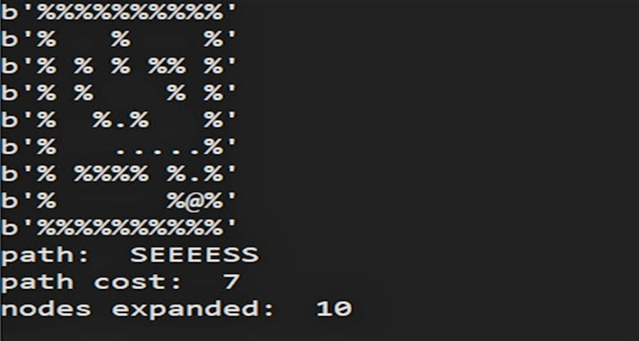
Result code
Tiny search
Path cost: 7
Node expanded: 10

Slide 37
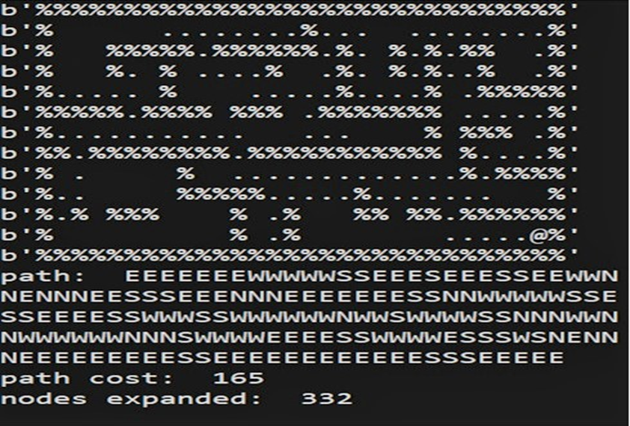
Result code
Small search
Path cost: 165
Node expanded: 332

Slide 38
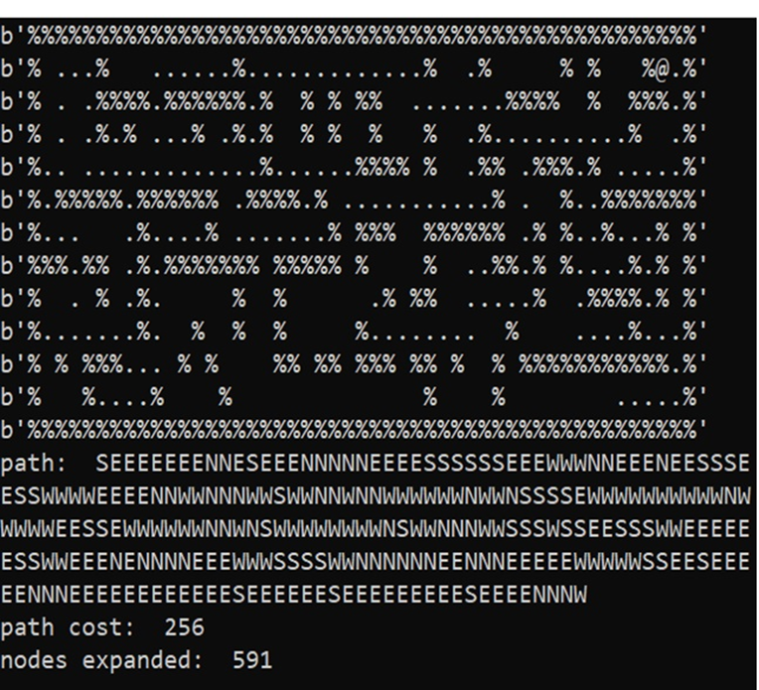
Result code
Medium search
Path cost: 256
Node expanded: 591

Slide 39
BFS search

Slide 40
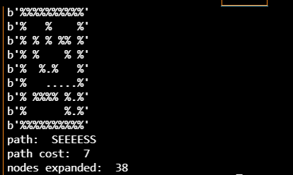
Result code
Tiny search
Path cost: 7
Node expanded: 38

Slide 41
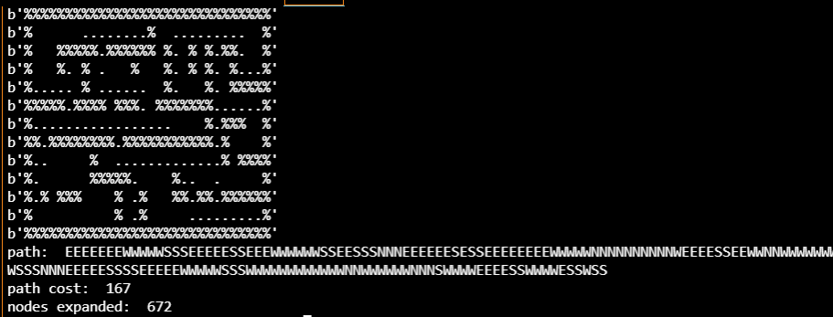
Result code
Small search
Path cost: 167
Node expanded: 672

Slide 42
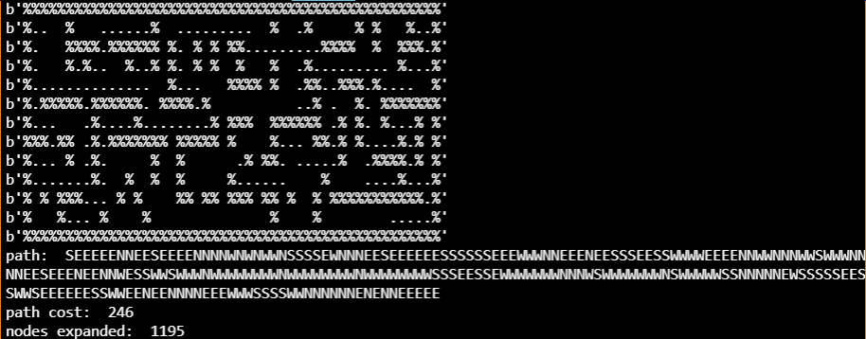
Result code
Medium search
Path cost: 246
Node expanded: 1195

Slide 43
Conclusion of Search with multiple dot(goal)
 | Path cost |  |  | Expanded nodes
 | tiny | small | medium | tiny | small | medium
BFS | 7 | 167 | 246 | 38 | 672 | 1195
A* | 7 | 165 | 256 | 10 | 332 | 591
From this table we can see that:
In small search : Best Search Algorithm is (A*), because A* search take the least Path Cost.
In tiny search : Best Search Algorithm is (A*), however both BFS and A* have the same Path Cost but A* Search used the least Expanded nodes.
In Medium Maze: Best Search Algorithm is (BFS), because BFS search take the least Path Cost.

